Slide 1
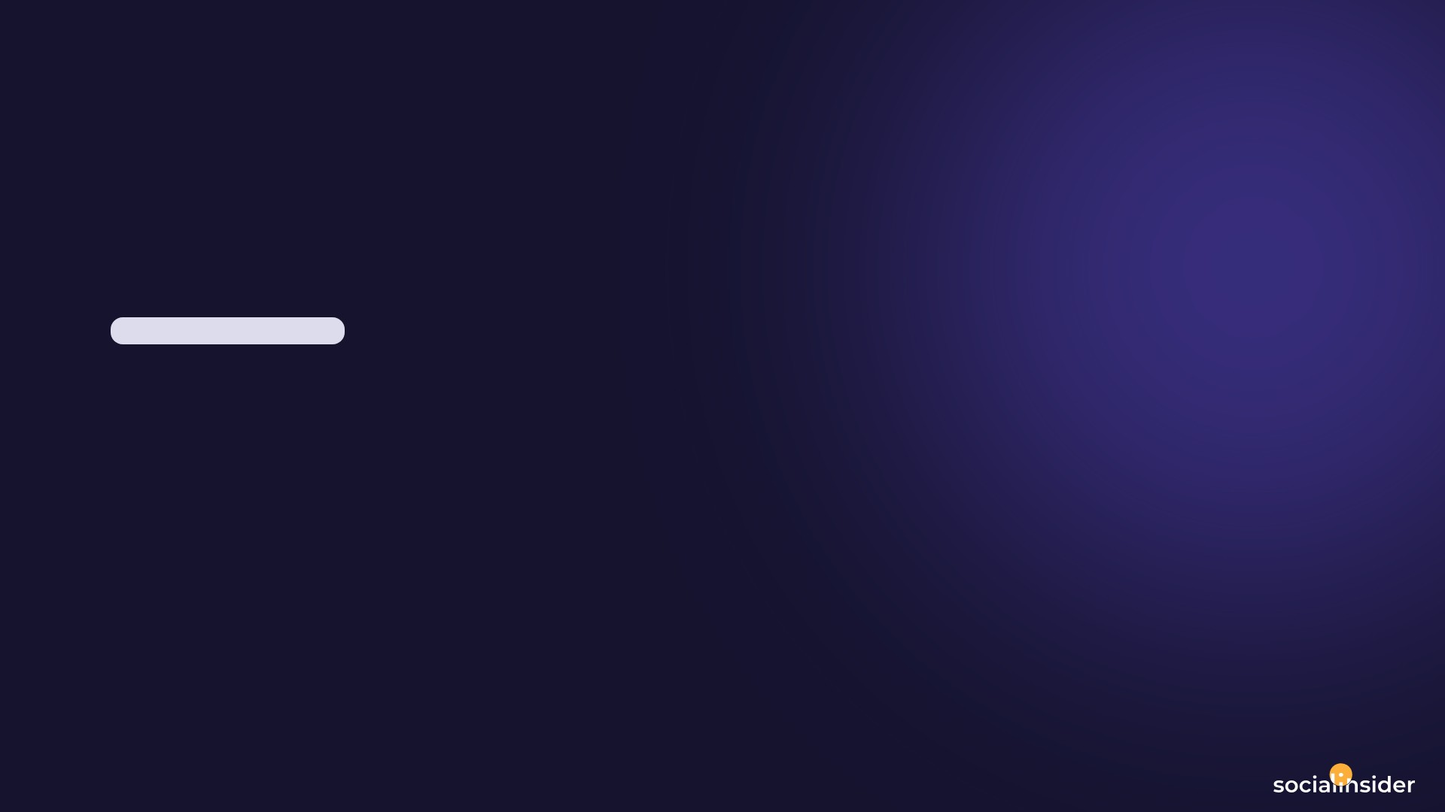
PUKHRAJJEWELLS_SILVERNGP
Instagram Report
BRAND
PERIOD
COMPARISON PERIOD
CHANNEL
@pukhrajjewells_silverngp
20 Jun 2026 - 19 Jul 2026
21 May 2026 - 19 Jun 2026
Instagram

Slide 2

SILVANA
EXECUTIVE SUMMARY
2/12
Between June 20 and July 19, SILVANA's Instagram profile experienced a dynamic growth phase highlighted by significant increases in engagement and reach. The follower base grew modestly by 504 new followers, representing a growth rate of 0.85%.Notably, the posting activity more than doubled, with 55 posts made compared to just 21 in the previous period, predominantly consisting of reels. This surge in content production drove remarkable enhancements in audience interaction, with total engagement soaring to 178,707 from 22,743 previously, and average engagement per post nearly tripling to 3,249.22.Likes and comments also rose considerably, indicating strong audience involvement. The profile's content reached over 6.7 million accounts, a vast improvement over 990,430 before, leading to over 10.7 million total impressions and an engagement rate per post at 5.41%, significantly up from 1.82%.These factors contributed to elevated earned media values, underscoring the increased brand exposure and influence during this timeframe. Overall, SILVANA's strategic increase in posting frequency, especially with reels, effectively enhanced visibility and audience engagement.
Source: Socialinsider
Date range: 20 Jun 2026 - 19 Jul 2026

Slide 3
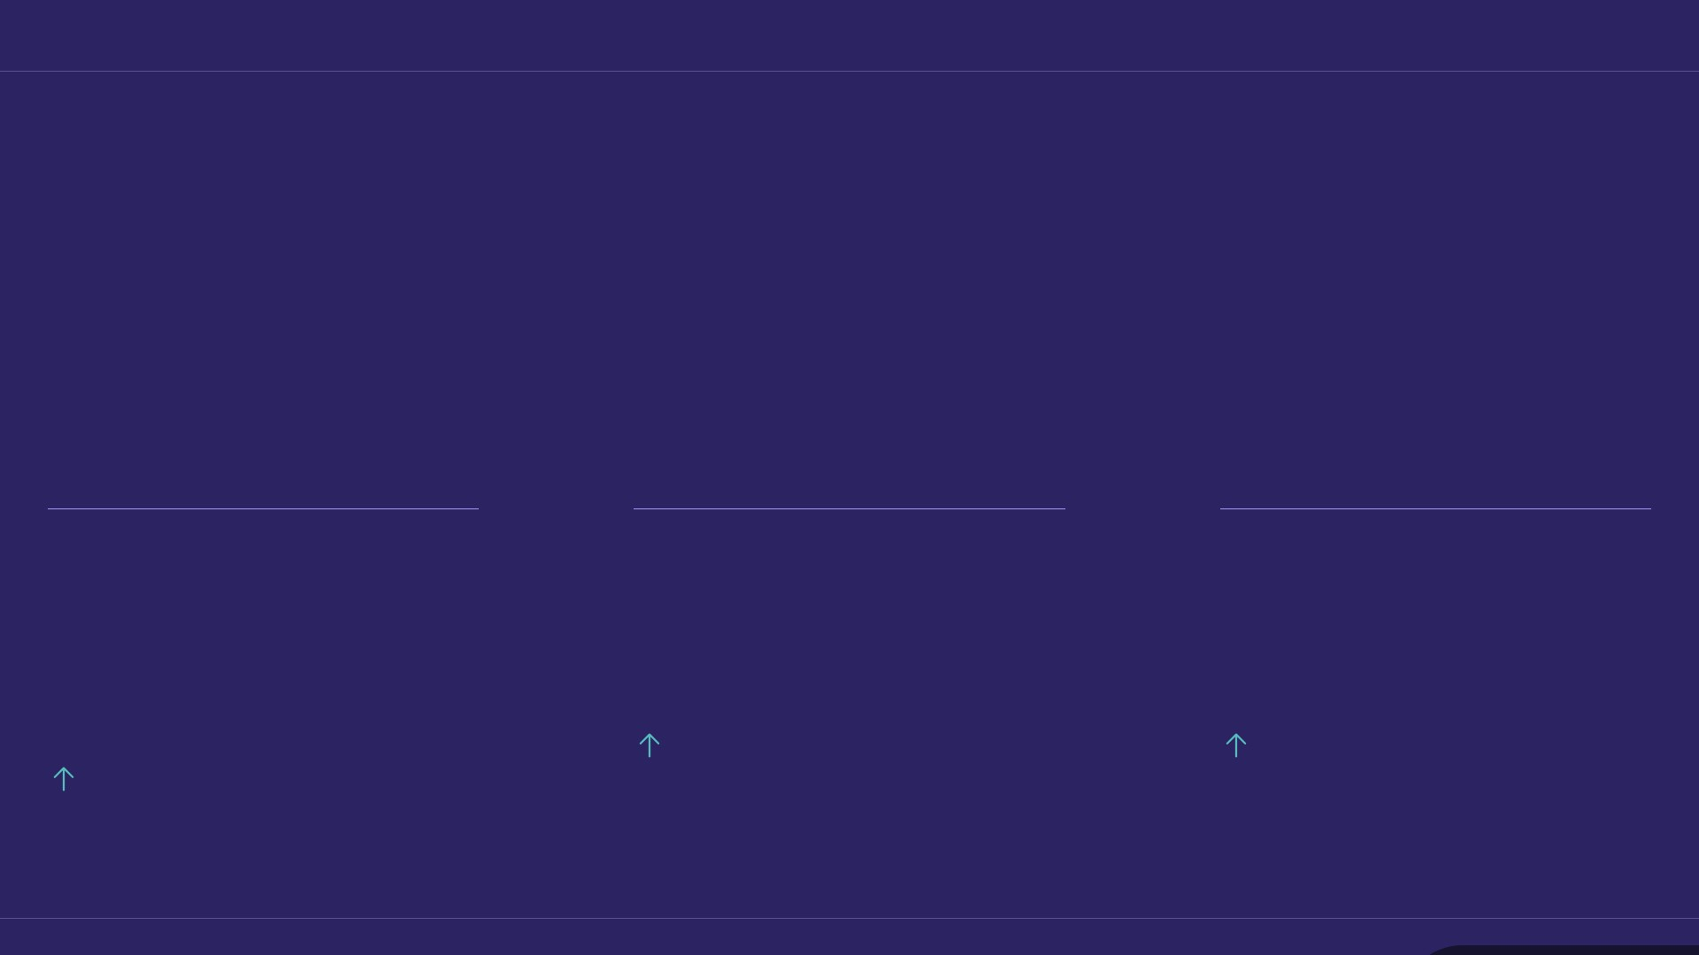
KEY INSIGHTS
3/12
One month, three numbers
A strong period — most metrics moved in the right direction.
5.41 %
10.8M
6.7M
Avg. Engagement Rate by Followers
Organic Posts Views
Organic Posts Reach
579.02%
579.02%
197.29%
Source: Socialinsider
Date range: 20 Jun 2026 - 19 Jul 2026

Slide 4
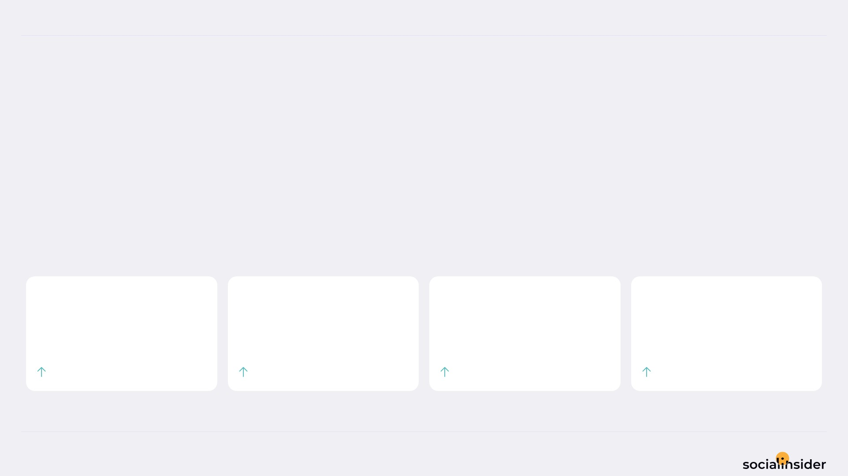
SILVANA
POSTS PERFORMANCE
4/12
POSTS TO ENGAGEMENT
We posted 161.90% more, and got 685.77% more engagement.
The engagement gain ran 4.2x ahead of the output increase. Quality compounded.
TOTAL POSTS
TOTAL ENGAGEMENT
AVG ENGAGEMENT / POST
AVG ENGAGEMENT / DAY
55
178.7K
3,249
5,957
161.9%
685.77%
200.02%
685.77%
Source: Socialinsider
Date range: 20 Jun 2026 - 19 Jul 2026

Slide 5
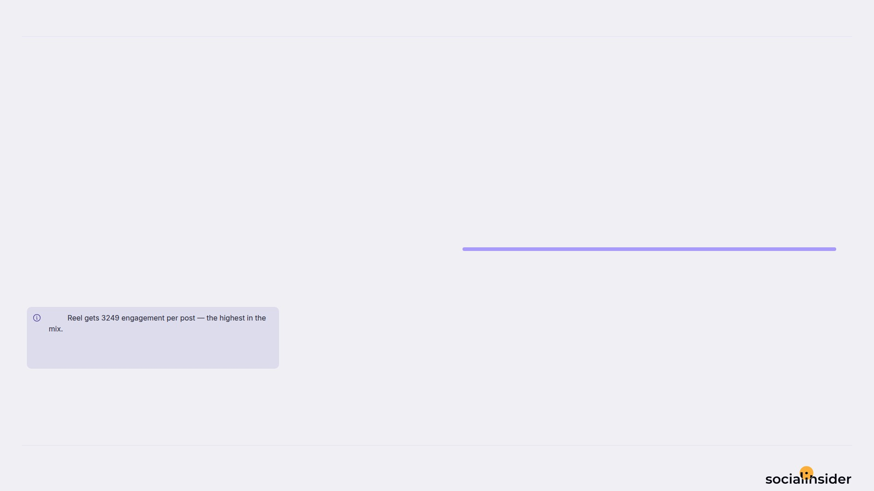
SILVANA
5/12
WHAT WE PUBLISHED
Reel made up the majority of posts published during this period.
Reel
55
Reel accounted for 100% of posts and 100% of engagement.
Note
Source: Socialinsider
Date range: 20 Jun 2026 - 19 Jul 2026

Slide 6
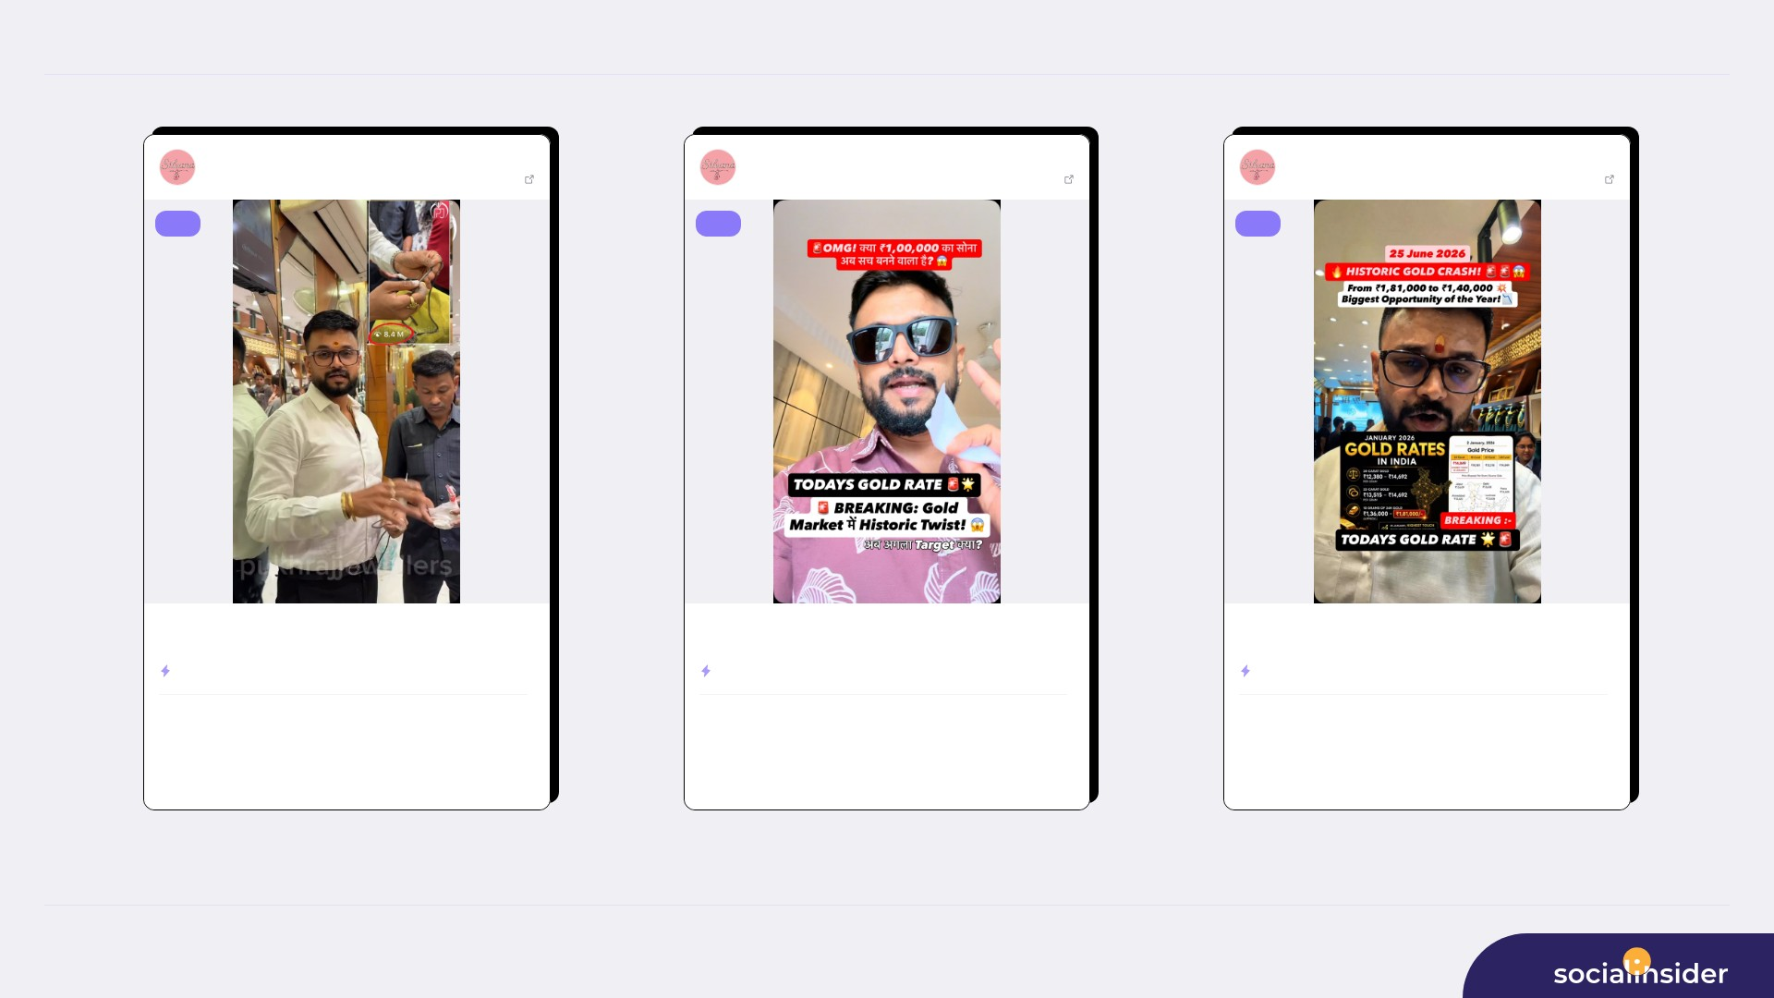
TOP CONTENT
6/12
SILVANA
Jul 02, 2026
SILVANA
Jun 30, 2026
SILVANA
Jun 25, 2026
60012 followers
View post
60012 followers
View post
60012 followers
View post
reel
reel
reel
Chandi hali ho jae… uska kala sach 😎✅ Sabko lagta hai silver sirf sa...
🚨 BREAKING: Historic Gold Rate Update! 📉😱 आज Gold Rate में एक और ब...
🚨😱 HISTORIC DROP IN GOLD RATE! 💥💥 At the beginning of the year, g...
ENGAGEMENT RATE
175.26%
ENGAGEMENT RATE
9.82%
ENGAGEMENT RATE
8.49%
5.7M
104.6K
478.5K
5,789
346.2K
5,029
VIEWS
LIKES
VIEWS
LIKES
VIEWS
LIKES
551
3.6M
105
298.1K
69
215.7K
COMMENTS
REACH
COMMENTS
REACH
COMMENTS
REACH
Source: Socialinsider
Date range: 20 Jun 2026 - 19 Jul 2026

Slide 7
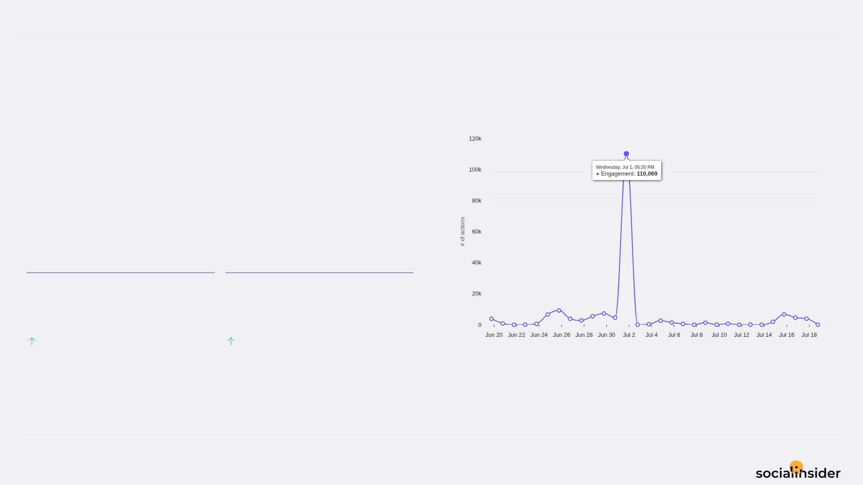
SILVANA
ENGAGEMENT
7/12
Engagement trend over the selected period
173.9K Total Organic Likes — a volatile period.
Both Total Organic Likes and Total Organic Comments improved this period.
TOTAL ORGANIC LIKES
TOTAL ORGANIC COMMENTS
173.9K
4,761
705.34%
316.17%
Source: Socialinsider
Date range: 20 Jun 2026 - 19 Jul 2026

Slide 8
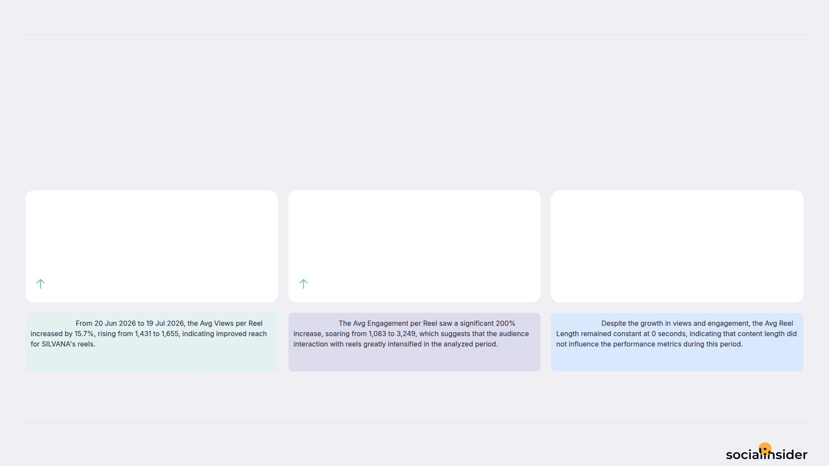
SILVANA
REELS
8/12
Key metrics for reels published during the period
Reels was mixed — some metrics increased while others decreased.
AVG VIEWS / REEL
AVG ENGAGEMENT / REEL
AVG REEL LENGTH
1.7
3,249
0
15.72%
200.02%
0%
Observation:
Observation:
Observation:
Source: Socialinsider
Date range: 20 Jun 2026 - 19 Jul 2026

Slide 9
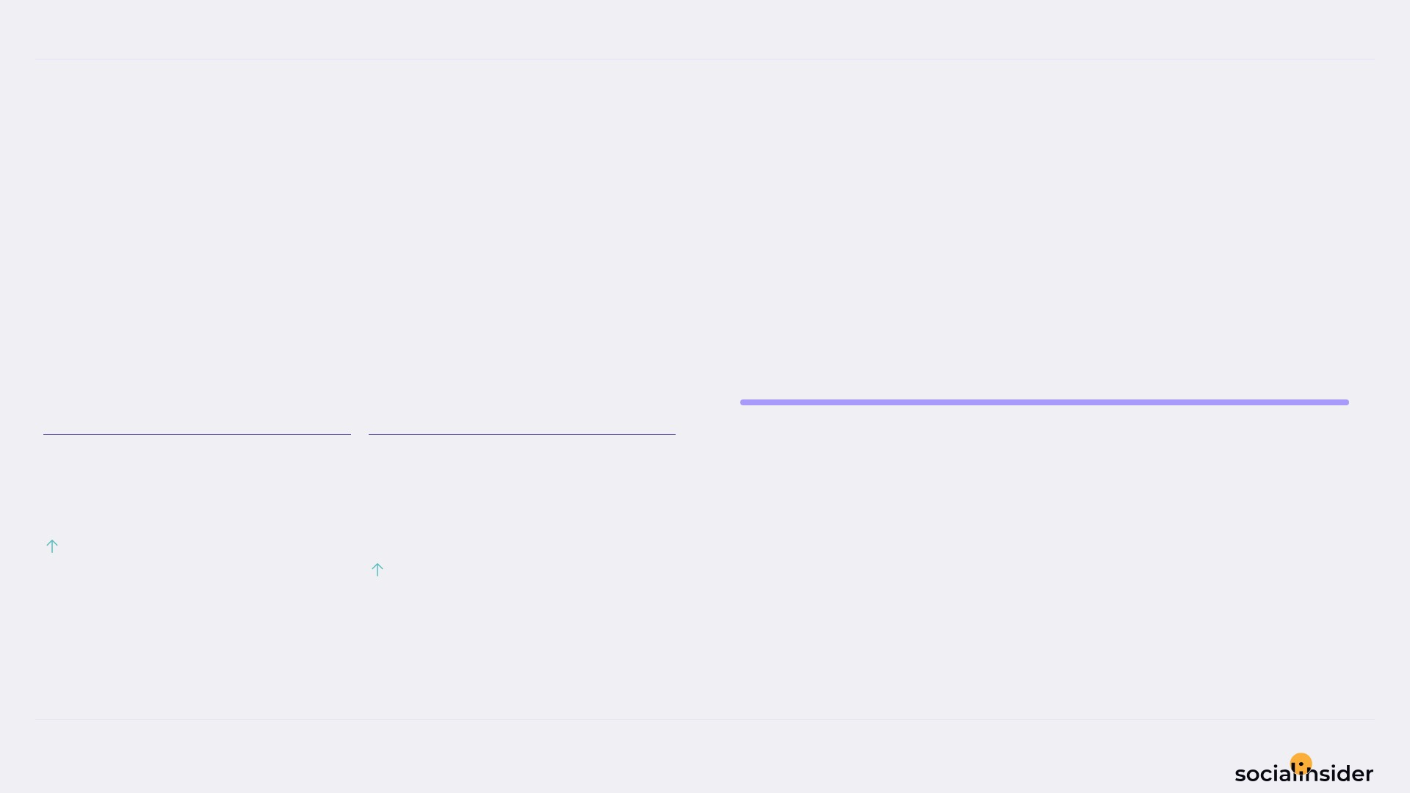
SILVANA
REACH
9/12
Reach performance broken down by post type
122.3K Avg Reach / Post — holding steady.
Both Avg Reach / Post and Avg Engagement Rate by Reach improved this period.
Reel
6.7M
AVG REACH / POST
AVG ENGAGEMENT RATE BY REACH
122.3K
2.5
%
579.02%
26.99%
Source: Socialinsider
Date range: 20 Jun 2026 - 19 Jul 2026

Slide 10
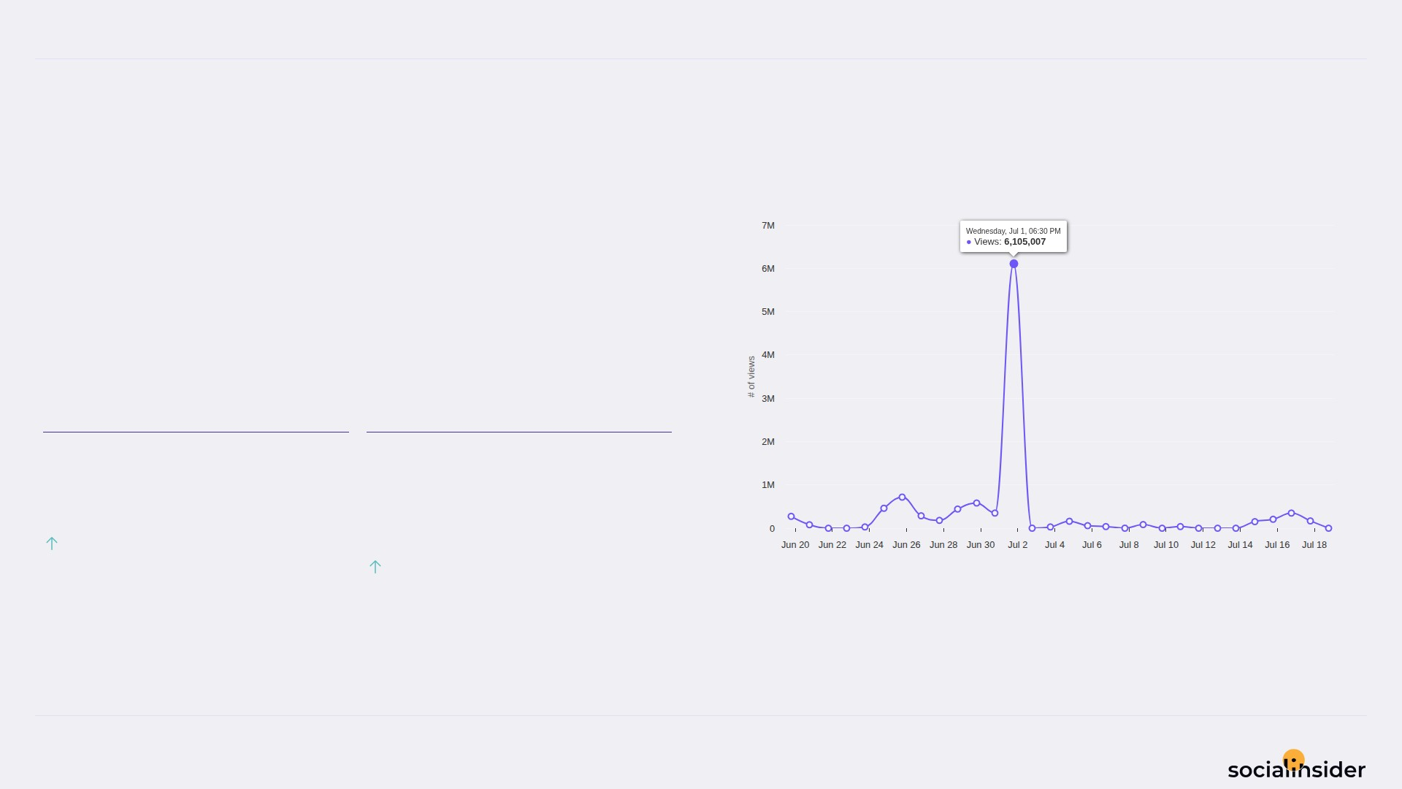
SILVANA
VIEWS
10/12
Views performance
196.3K Avg Views / Post — a volatile period.
Both Avg Views / Post and Avg Engagement Rate by Views improved this period.
AVG VIEWS / POST
AVG ENGAGEMENT RATE BY VIEWS
196.3K
1.6
%
159.26%
26.99%
Source: Socialinsider
Date range: 20 Jun 2026 - 19 Jul 2026

Slide 11
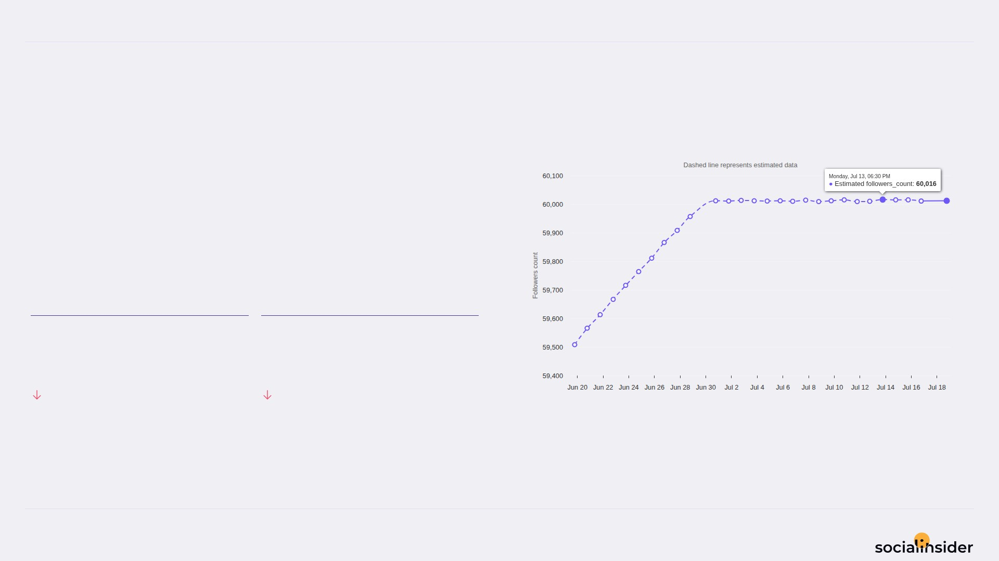
SILVANA
FOLLOWERS
11/12
Follower growth trend over the selected period
504 Follower Growth — holding steady.
Both Follower Growth and Followers Growth % declined this period.
FOLLOWER GROWTH
FOLLOWERS GROWTH %
504
0.8
64.73%
65.6%
Source: Socialinsider
Date range: 20 Jun 2026 - 19 Jul 2026

Slide 12

REFERENCE
12/12
Definitions and reference materials for this report
Glossary & Resources
Scope
Definitions
Resources
Period
Engagement
Socialinsider Blog
20 Jun 2026 - 19 Jul 2026
The sum of likes and comments on the organic posts
socialinsider.io/blog
Comparison Period
Engagement Rate by Followers
Socialinsider Help Center
21 May 2026 - 19 Jun 2026
Engagement divided by follower count, expressed as a percentage
https://howto.socialinsider.io/en/
Social Channel
Reach
Socialinsider Studies
Instagram
Number of unique accounts that saw your content
https://www.socialinsider.io/reports
Content Analysis (posts analyzed)
Views
55
Total number of times your content was displayed
Source: Socialinsider
Date range: 20 Jun 2026 - 19 Jul 2026

